Slide 1
Nearables
Team: Uncharted-5
Hrishikesh Rendalkar
Harini Balakrishnan
Swetha Chandrasekar
Sourabh Namilikonda
Hemambujam Veeraraghavan

Slide 2
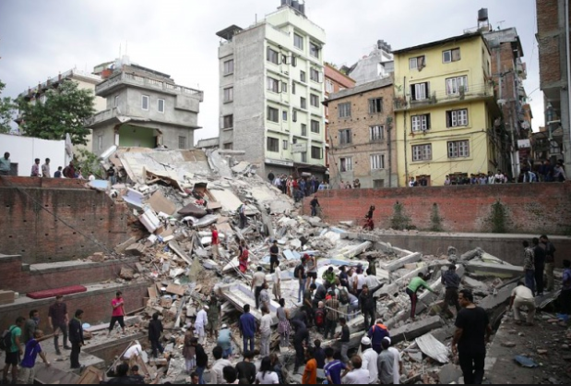
Problem Statement1 :
During earthquakes many people are trapped under the debris and its difficult to search these people. Exact count of people trapped is difficult to get.

Slide 3
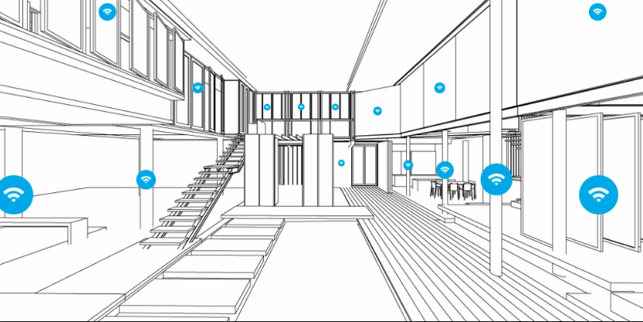
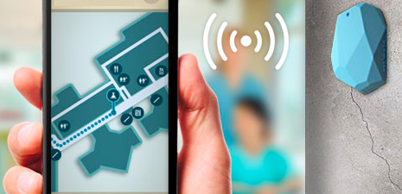
Problem statement 2 :
During fire accidents or any natural calamities its difficult to search your way out of the stores e.g. Walmart

Slide 4
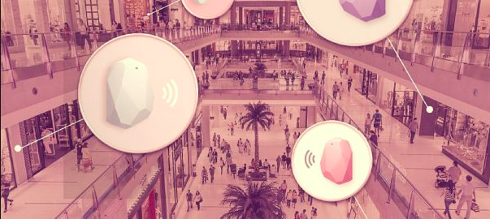
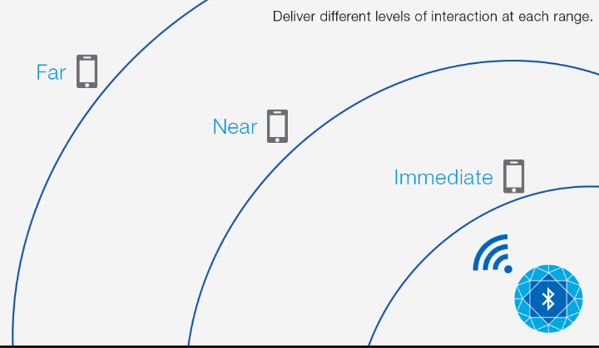
Solutions:
Easy to track people in need of help without getting into a debris
Finding nearer exits in a huge retail store during disasters
No internet connection required, works on Bluetooth and can be attached to Bluetooth able devices like fitbit or apple watch.
Easy to attach onto people/pets/objects. Space utilization and optimization.

Slide 5
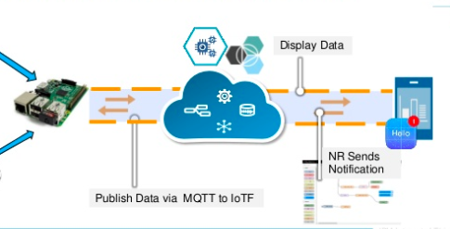
Future enhancements
Collect data from all beacons around using node.js using a Raspberry Pi or a BLE (Bluetooth Low Energy). Use Beacon gateway and broadcast the information via MQTT to IBM IoT and Bluemix platform.

